Slide 1


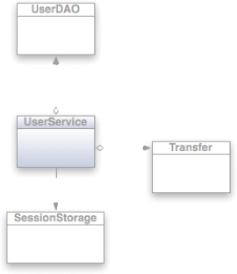

Mock it baby!
Leveraging Mock Objects

Slide 2



The Obligatory Who am I?
Husband
Dad
Coach
Youth leader
Co-owner of Computer Know How
Member of TEAM ColdBox

Slide 3


What we will cover?
Unit Testing Recap
Testing Toolbox
What is Mocking?
What is a Mock Object
Why Mock?
Mocking Frameworks
Practical Mocking with MockBox

Slide 4


Why Unit Testing?
Can improve code quality -> quick error discovery
Code confidence via immediate verification
Can expose high coupling
Will encourage refactoring to produce > testable code
Remember: Testing is all about behavior and expectations

Slide 5
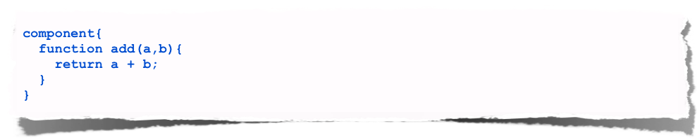
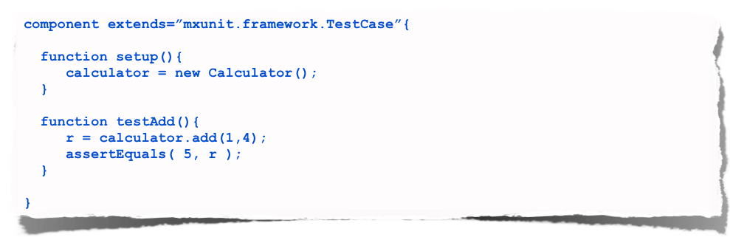
Unit Testing Basics
SUT
Unit Test

Slide 6
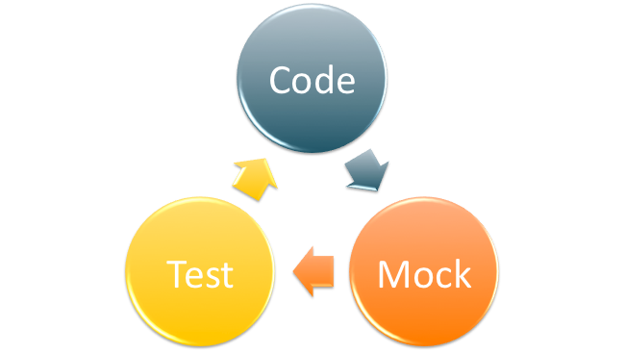

TDD Process
Test Driven Development
Can be a new development paradigm for some
Work from the IDE
RED (Write the unit test, obviously fails)
GREEN (Write the code that makes the unit test pass)
RINSE AND REPEAT (This is a cycle as you code)

Slide 7

The 6 P’s
Prior
Planning
Prevents
Piss
Poor
Performance

Slide 8





Testing ToolBox
MXUnit
ColdFusion Builder OR CFEclipse
A mocking framework (MockBox)
ANT
Integration Testing
ColdBox
Selenium
BadBoy
JMeter or Webstress Tool
Jenkins
MXUnit

Slide 9

What is Mocking?
Lets have a moment?

Slide 10

Mocking
“To treat with ridicule or contempt; to imitate, to counterfeit”

Slide 11
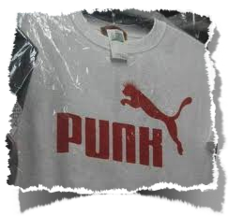
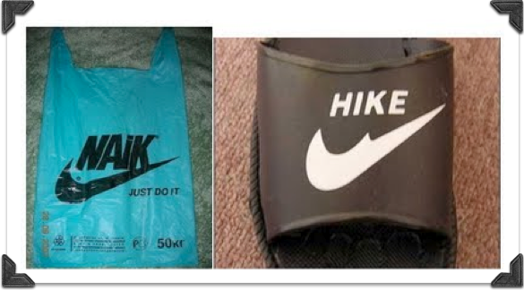
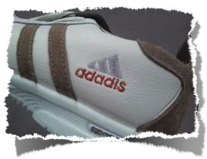
Mock Object
"A mock object is an object that takes the place of a 'real' object in such a way that makes testing easier and more meaningful, or in some cases, possible at all" by Scott Bain - Emergent Design
Text

Slide 12


Why Mock?
Because you are immature!
Isolate your SUT -> Software Under Test
To build against interfaces & contracts
Building against missing integration pieces
To control data and expectations
Mock components whose behavior is undesirable or hard to control
Text
A mock is essentially the interface without any real implementation

Slide 13

Why Mock?
How do you test when helper components that are not built yet?
How do you do controlled exceptions?
How do you test & control external API calls?
How do you control results from ColdFusion tags or functions?
How do you control network connections? Do you pull the network plug?

Slide 14
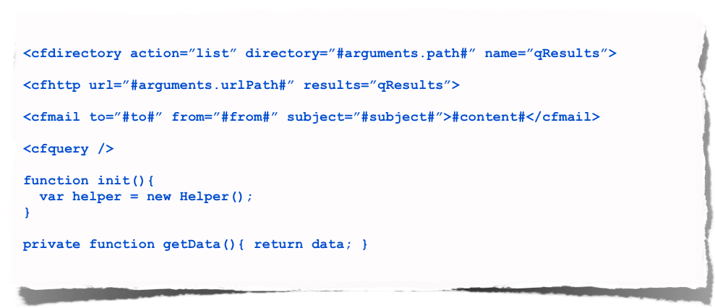
Why Mock?
How do you test the following?
Some code is untestable or we would need some serious world of hurt to test

Slide 15

Benefits
Build test friendly code (refactor) and use a DI engine (WireBox of course!)
Leverage utility components that can be easily mocked
Refactor to remove complexities and isolate dependencies
Smaller and more focused methods
Improve code reuse
Our tests can say a lot about our code

Slide 16

When to Mock?
You're mocking me, aren't you?
When it’s appropriate…
When using TDD (Test Driven Development)
When you’re early in the development cycle
When you’re agile and you need results from functionality not built yet

Slide 17
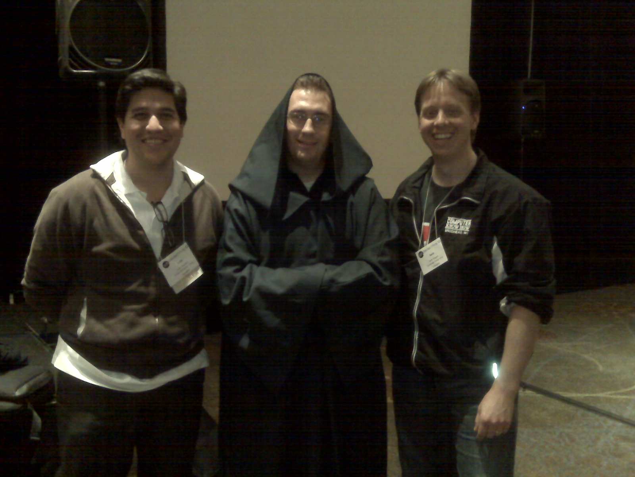
What are we mocking?
Entire Components
Methods
Properties
Data
Exceptions
Curt??

Slide 18
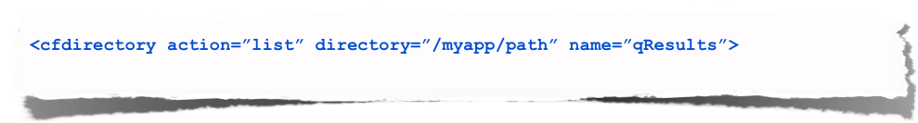
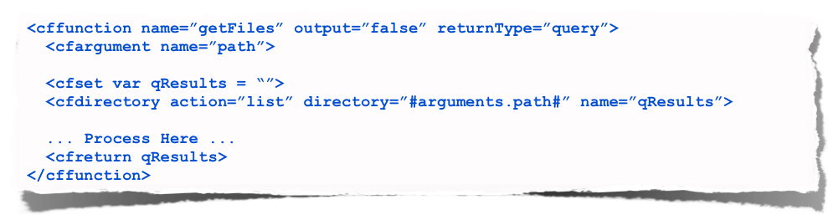
Refactor Example
Original
Refactored

Slide 19
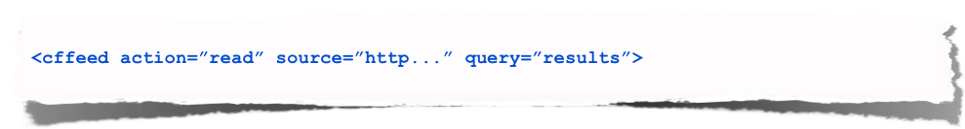
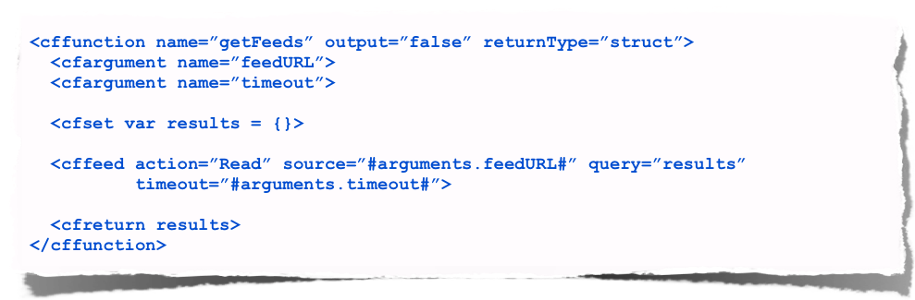
Refactor Example
Original
Refactored

Slide 20
Refactoring Thoughts
First thoughts
Dumb!
I’ll end up with lots of small utility methods
More work?
Mature thoughts
Cool!
I’ll have more granular and reusable methods that can be mocked easily
Makes my code cleaner
Logical code separation

Slide 21
Typical Example
ORM
DAO
Service
Settings
Domain Objects

Slide 22
Typical Example
Mock ORM
Mock DAO
Service
Mock Settings
Mock Domain Objects

Slide 23
Mocking Frameworks
MockBox by ColdBox
MightyMock by MXUnit
ColdMock
Showcase MockBox as well... We built it

Slide 24

Key Features
Mock Objects with or without implementations
Mock methods & properties in any scope
Create Stub Objects -> Non-existent objects
Mock exceptions
Mock arguments to results
Logging & Debugging
Verification methods
State Machine Results

Slide 25
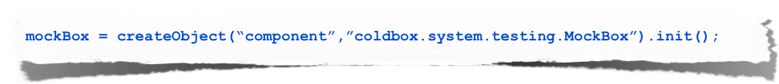

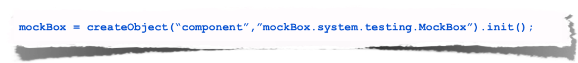
Setting up MockBox
ColdBox Embedded
ColdBox Base Tests = Easier Integration
Standalone

Slide 26
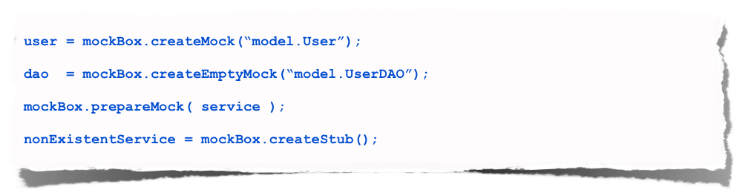
Creation Methods
CreateMock()
CreateEmptyMock()
PrepareMock()
CreateStub()
Creates & Decorates Objects Dynamically!

Slide 27
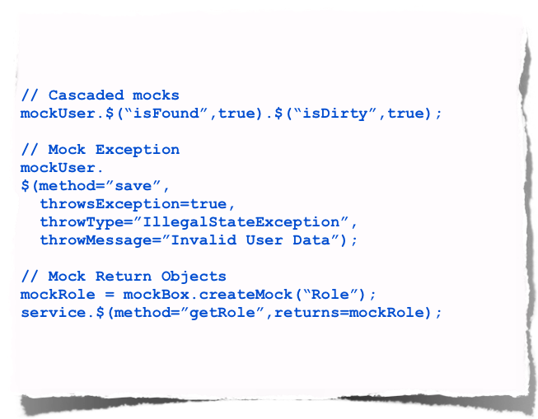
$()
Shortcut for mockMethod
Arguments
method
returns
preserveReturnType
throwException
throwType
throwDetail
throwMessage
callLogging

Slide 28
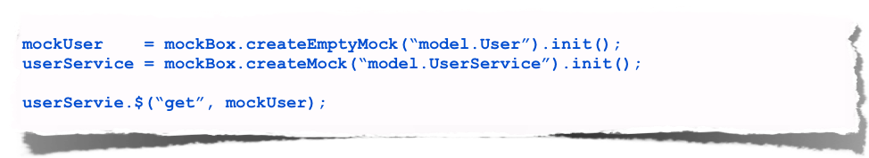
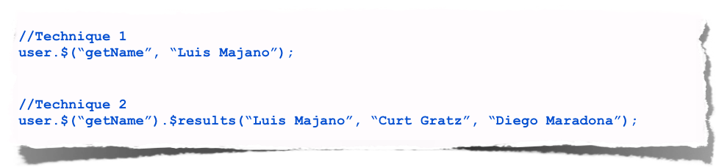
$()
Setup
Mock methods

Slide 29
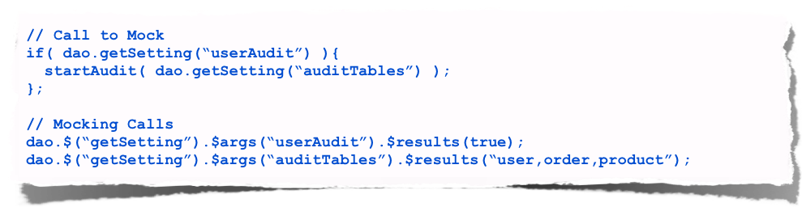
$args()
Argument directed results
MUST be chained via $results()
You can use:
Named parameters
Positional parameters
Argument Collection - CF Upper Cases Arguments

Slide 30

$args()
Named Parameters
saveUser(fname=”luis”,lname=”majano”);
Positional Parameters
saveUser(”luis”,”majano”);
Argument Collection
data = { fname = “luis”, lname = “majano” }; saveUser(argumentCollection=data);

Slide 31
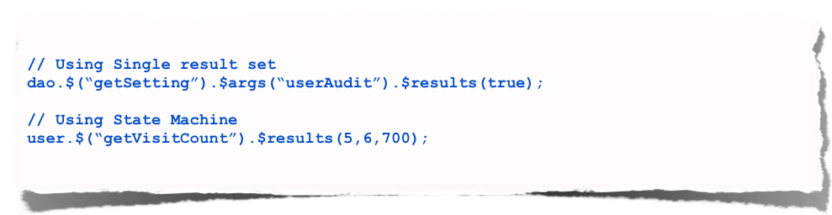
$results()
State machine your results
Repetition sequence
$results(1,2,3) + Called 5 Times = 1,2,3,1,2

Slide 32
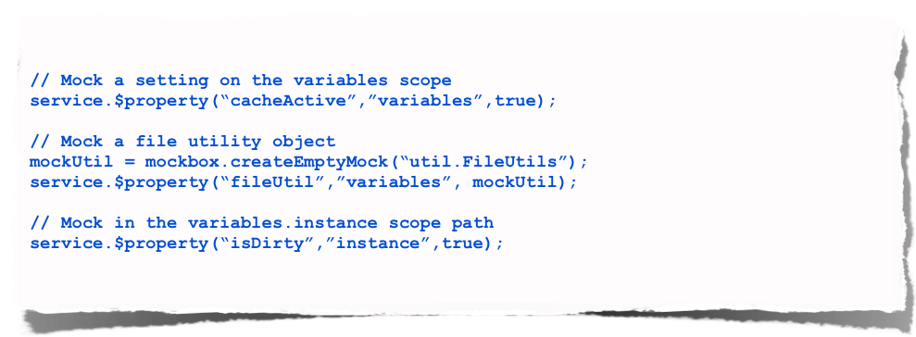
$property()
Mock any property on any scope
Great for settings, aggregation or composition mocking

Slide 33
Code - Discussions

Slide 34

Resources
Unit Testing
www.mxunit.org
Mocking
www.mxunit.org
wiki.coldbox.org/wiki/MockBox.cfm
ColdBox Resources
www.coldbox.org
wiki.coldbox.org
groups.google.com/group/coldbox
Professional Support & Training
www.ortussolutions.com
Curt Gratz &
Computer Know How
gratzc@compknowhow.com
Blog: http://www.coldbox.org/blog
Twitter: gratzc
G-Talk: gratzc@compknowhow.com

Slide 35
Q & A
Don’t forget the evals
Thanks!

